Slide 1
Reactants and Products

Slide 2
By the end of this lesson, you should be able to:
• | Understand the relationship between the reactants and products of a reaction.
• | Recount the process of the breaking of an existing atomic bond, and formation of a new atomic bond.
• | Contrast a spontaneous and nonspontaneous reaction.
• | Identify the indicators of a chemical reaction having had occurred.

Slide 3

In a chemical reaction, an existing substance is changed into a different and new substance.
We can represent this change of substances using a diagram:
For example, when iron and oxygen are mixed with water, they undergo a chemical reaction and combine to make rust. The iron, oxygen and water are the reactants, and the rust is the product.

Slide 4
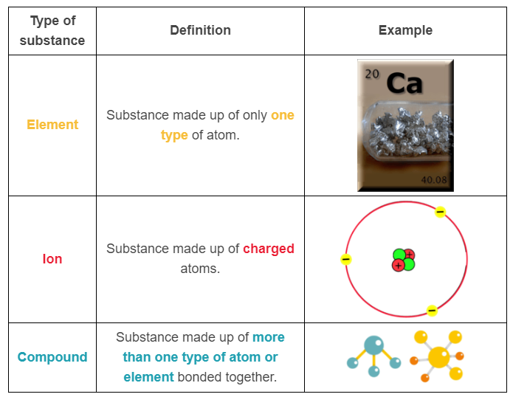

Slide 5
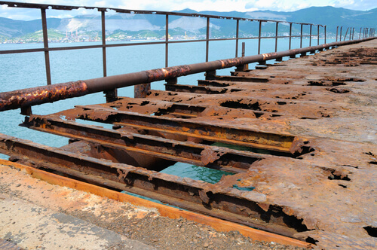
Let us revisit our previous example of making rust.
The reactants, oxygen and iron, were both elements.
The product, rust, was a compound because it was composed of multiple elements.

Slide 6
So how do reactants change into products?
During a chemical reaction the atoms in the reactant are rearranged.
This is done by breaking old bonds between atoms and forming new bonds.
The different arrangement of the atoms makes a different substance.

Slide 7
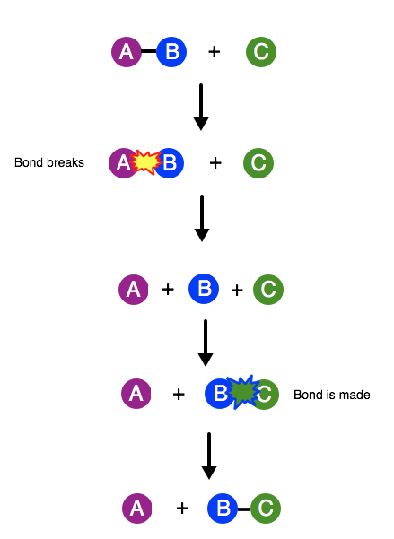
Here is a diagram showing atomic bonds being broken and formed.
The starting substances are an A-B compound and a C type element.
During the chemical reaction, the bond between the A and B atoms is broken and a bond between B and C is formed. This destroys the original substances.
It also makes new substances: an A type element and a B-C compound.
Thus, by rearranging atoms, the product is different from the original substances.

Slide 8

Lets look at the formation of water:
In this diagram, the starting substances, on the left of the arrow, are the elements, hydrogen and oxygen.
The two hydrogen molecules are made of two blue hydrogen (H) atoms bonded to one another.
The oxygen molecule is made of two purple oxygen (O) atoms bonded together.
In the chemical reaction, all bonds are broken. Two hydrogens are then bonded to each oxygen atom.
This makes a new substance: the compound water (H₂​O).

Slide 9
This rearrangement of atoms is very important.
The starting elements, hydrogen and oxygen, are both gases at room temperature.
The new compound, water, is a liquid.
The reason these substances differ is that the arrangement of a substance's atoms determines its properties. These properties include its colour, density and phase (eg. gas). That is why we look for things, like phase changes, when identifying reactions.
See now how rearranging atoms can make entirely different substances?

Slide 10
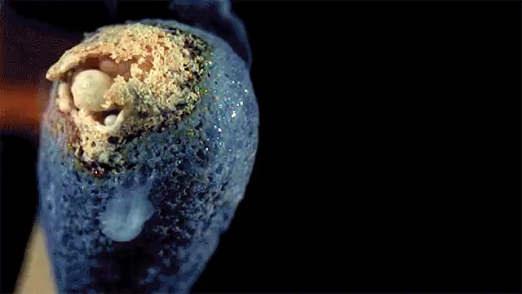
A reaction is classed as spontaneous or nonspontaneous depending on whether it requires an energy input.
You might have noticed that old nails are often rusty, or that in order for wood to burn, it needs to be lit. These are examples of spontaneous and non-spontaneous reactions.

Slide 11
If a reaction occurs all on its own, i.e. without the involvement of an external factor to facilitate it, then it is called spontaneous.
The gif below shows the reaction between sugar and sulfuric acid. When the sulfuric acid is added to the sugar, it removed the water from the sugar, releasing heat, steam and sulfur oxide fumes.

Slide 12
"Spontaneous" does not refer to the speed of the reaction.
If a reaction is spontaneous, it can happen at any speed.
Diamond decaying to graphite takes millions of years, but is still classed as a spontaneous reaction as it does not require the input of an external factor!

Slide 13

While it might seem like it would be a nonspontaneous reaction, combustion reactions are actually spontaneous!
If enough heat is added to start a reaction, and that reaction can continue without the continuing addition of heat, it is spontaneous!
For example, in the gif below, some steel wool is lit on fire with a match. It continues to burn without having to re-light it with the match, so is spontaneous!

Slide 14
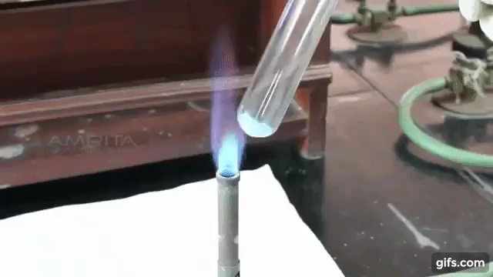
If a reaction requires an energy input, such as heat or light, it is called a nonspontaneous reaction.
If you have to use a bunsen burner for a reaction to happen then your reaction is definitely nonspontaneous.
Additionally, certain substances will not react at all, even if energy is added.

